Slide 1
Movie budget predictions
NAJLA BIN-MELHA
MUTAB ALZUBAIR
TAHANI ALDOSARI

Slide 2
Initial hypotheses on worldwide gross
Opening US domestic gross a strong predictor
Starry actors play a large role
Budget also important

Slide 3


Setting up the model
MPAA Rating
IMDB Rating
Genre
Runtime
Budget
Release Date
Actors
Scraped with BeautifulSoup
Generated an Actor Score based on highest grossing actors
Limited data set to movies showing in 100+ theaters
Target variable:
Worldwide gross ex US
IMDB
BOX OFFICE MOJO
Opening # Theaters
Opening Gross
Worldwide Gross
THE NUMBERS
Budget
Highest grossing actors

Slide 4
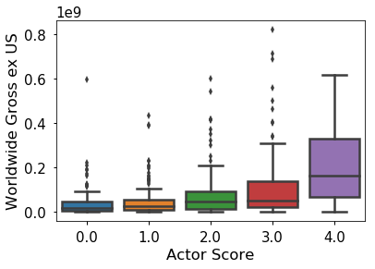
Initial EDA: high actor scores appear to be correlated with worldwide gross ex US

Slide 5


R2 is 0.625 for linear regression model

Slide 6
Ridge performs best across linear regression features
Train/Validation/ Test | R²
Linear Regression | 0.62477
Ridge Regression | 0.62481
Lasso Regularization | 0.62472
Polynomial Features | 0.44392
Cross- Validation/Test | R²
Linear Regression | 0.44575
Ridge Regression | 0.44613
Lasso Regularization | 0.44573
Polynomial Features | 0.44575
RIDGECV ARRAY
[0.61579173
-0.32579784
0.59130861
0.69818528
0.65115842]

Slide 7
Scaled Relative Feature Strength – Ridge; initial hypotheses seem to hold

Slide 8
Conclusion
Today’s big hits earn ~80% of their box office revenue internationally
Thinking about different audiences has become de rigueur
Next steps to improve prediction model:
Location of filming (filmed ex US?)
Plot (high-concept, universal appeal?)
Production company (large distribution network worldwide?)

Slide 9
THANK YOU

